Slide 1


IFMA Component Champions Training
Tools, Insights and Best Practices for Supporting IFMA’s Networking Groups
Copyright © 2023 ‹#›

Slide 2



Agenda
Champion Program Overview
Roles and Expectations Understanding Needs and Solutions Resources and Support
Champion Toolkit Q&A

Slide 3




About the IFMA Champions Program
Our Purpose
Supporting and equipping IFMA components worldwide with the resources they need.
Our Goals
Strengthening component capacity and building stronger connections between IFMA and its groups through direct engagement.
Build trust and open lines of communication through direct engagement
Equip components with relevant tools, resources and support needed
Support components in delivering value to IFMA members locally and globally
Ensure components recognize how their work fuels IFMA’s growth and impact

Slide 4
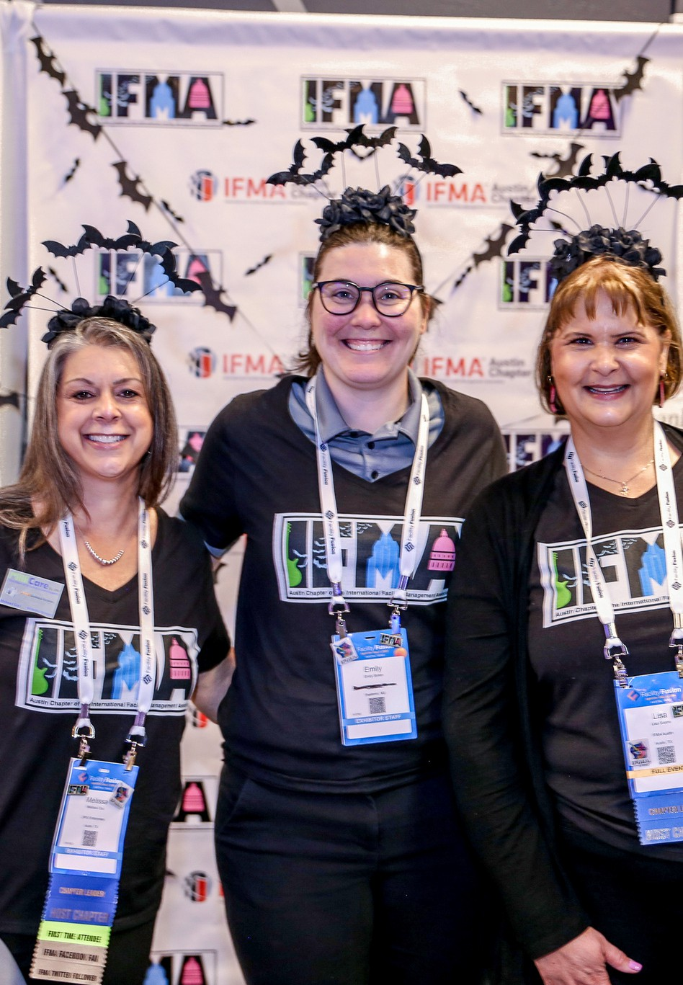
Component Participation
In the initial launch, only select Chapters were assigned a Champion
In 2023–2024, the program expanded to include Councils and Communities. Further expansion is planned.
What to Do if a Component Requests a Champion?
Refer all requests to the Components Team
The team maintains a list of interested Chapters, Councils and Communities for future consideration
Copyright © 2025

Slide 5
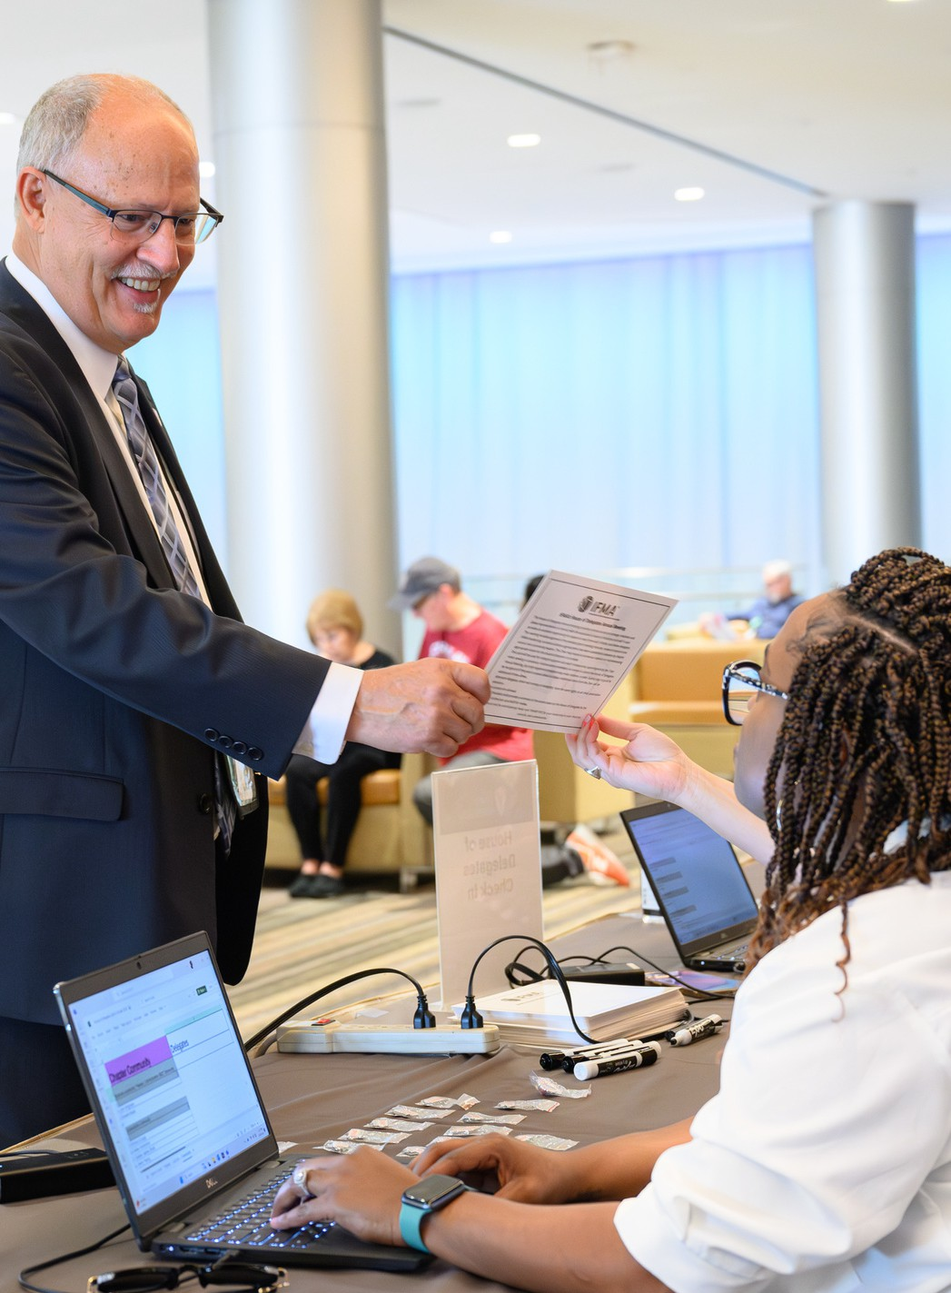
IFMA’s
Expectations of Champions
Participate in kickoff meeting
Champions will only need to participate in this meeting once in the lifetime of their service as a Champion.
1
Complete training workshop
Participate in a training workshop before making contact with their assigned component(s).
2
3+ contacts with Leaders
Engage with the board leaders of their adopted component(s) at least 3 times within the 18-month period of their term.
3
Provide feedback to Liaisons
Provide feedback to IFMA liaisons on staff following each component contact.
4

Slide 6

How IFMA Champions Serve
Focus on connecting with key leaders.
(President, 1st Vice Chair/President-Elect)
Identify gaps in leadership’s knowledge about services and programs.
Build trust and understand challenges and needs.
Utilize resources from the Champion Toolkit to develop solutions.

Slide 7
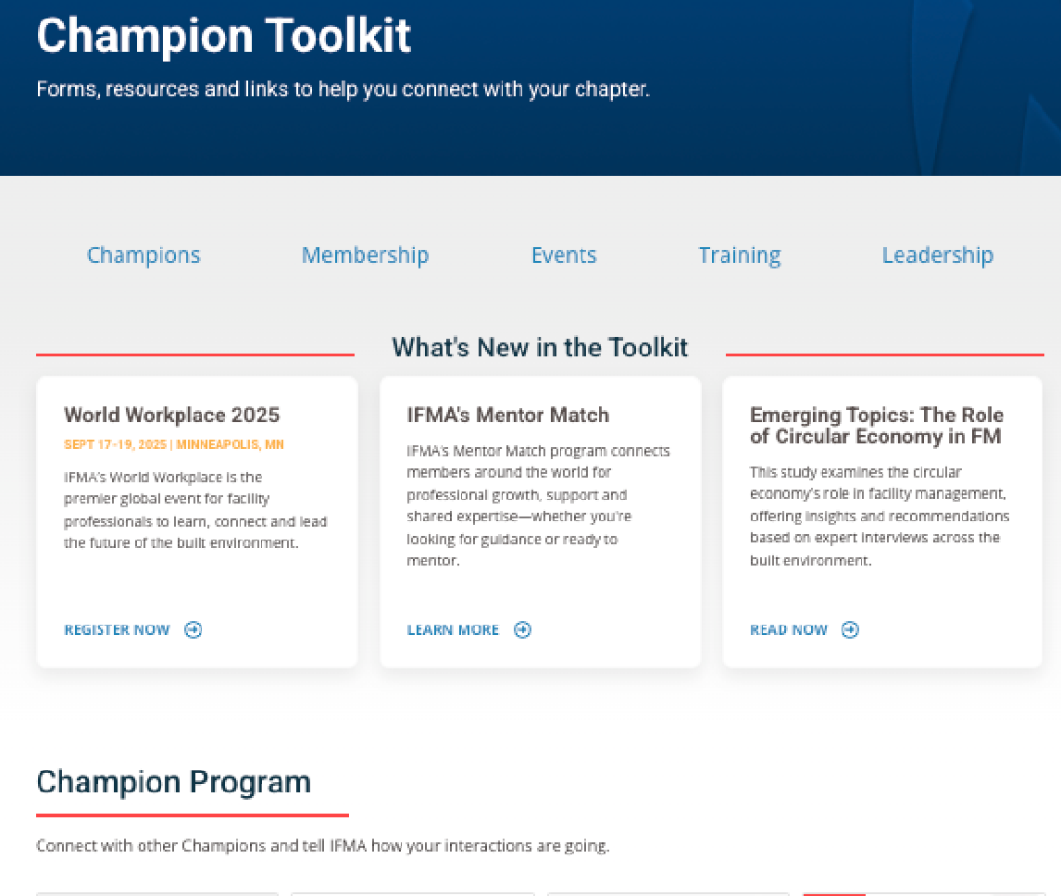
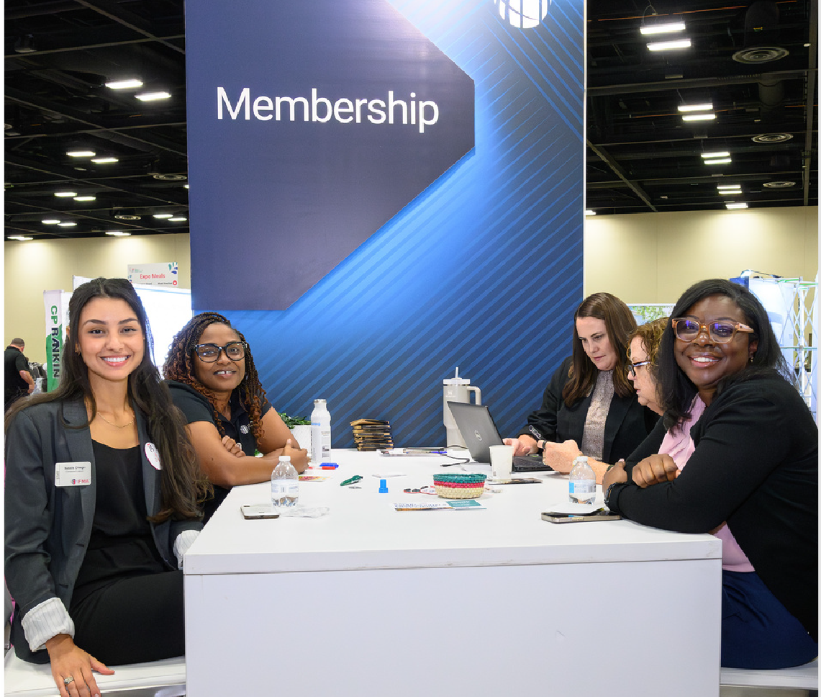
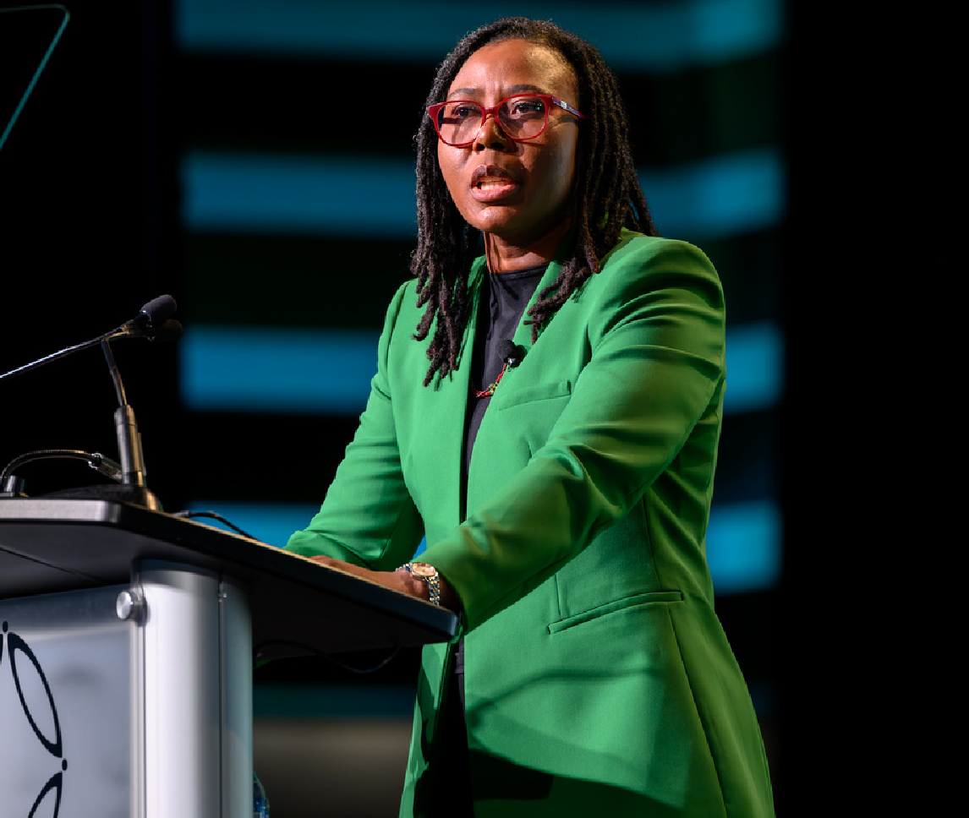



What Champions Can Expect from IFMA
IFMA provides Champions with the resources, support and recognition they need to build connections and make an impact.
Dedicated Support
A Component Liaison is assigned to you and your component for questions and support.
Recognition
Champions are recognized for their service at IFMA events and featured through IFMA’s marketing and communications.
The Champion Toolkit
Your one-stop shop for IFMA resources to support your component. Only for Champions — not available on IFMA’s public site.
Stay connected through the Champions Engage group — get updates, share ideas and access helpful tips and resources.

Slide 8
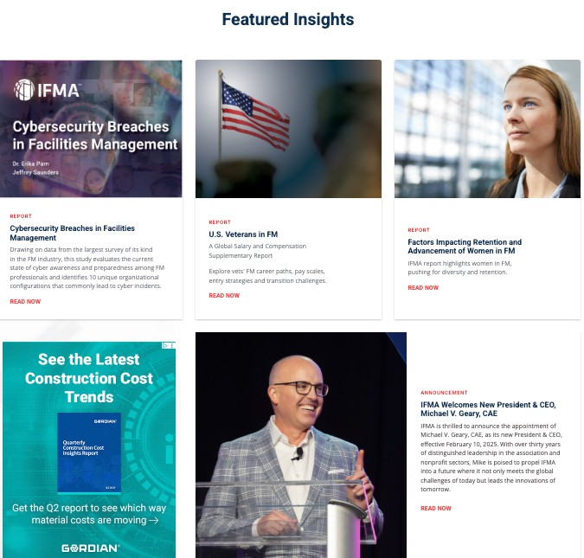
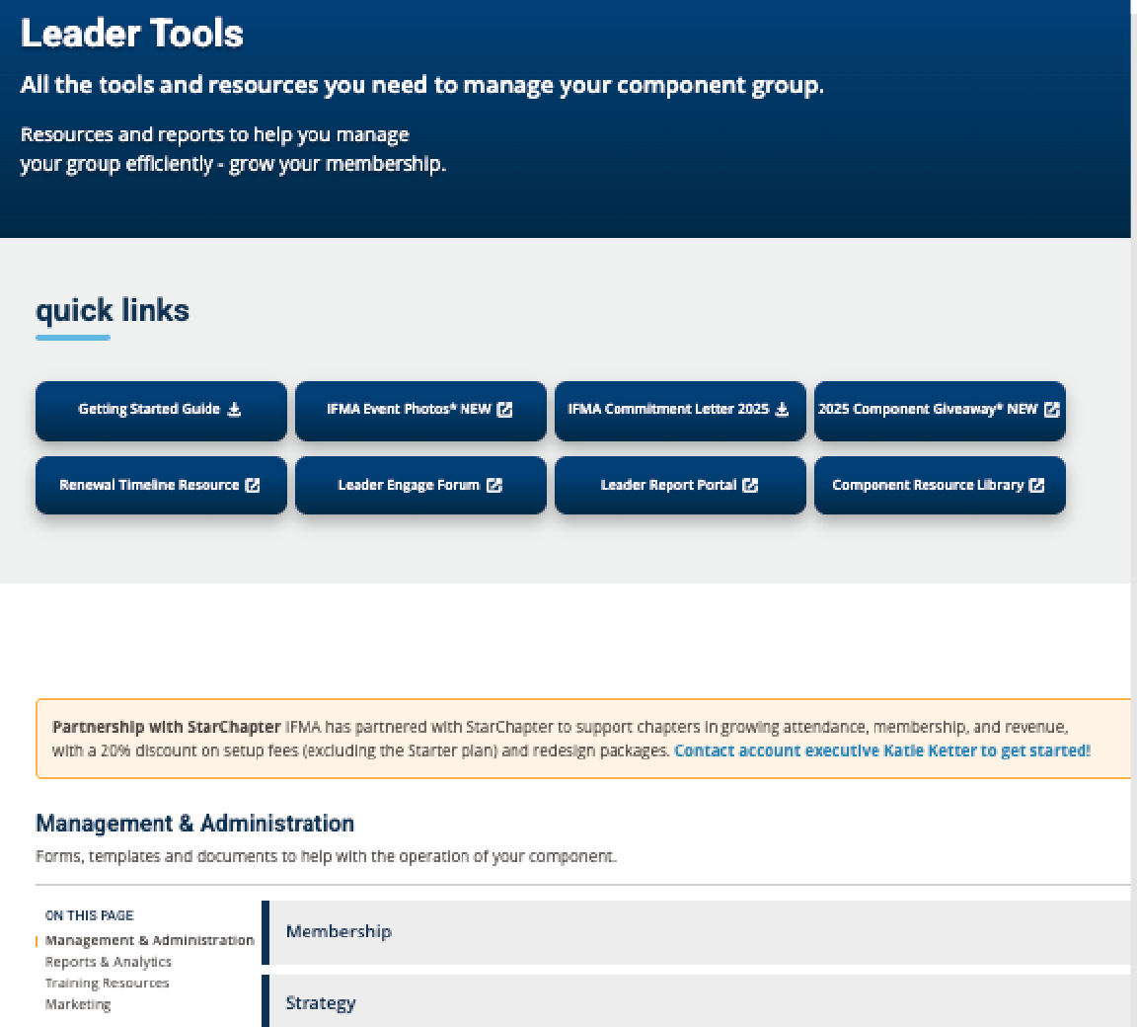
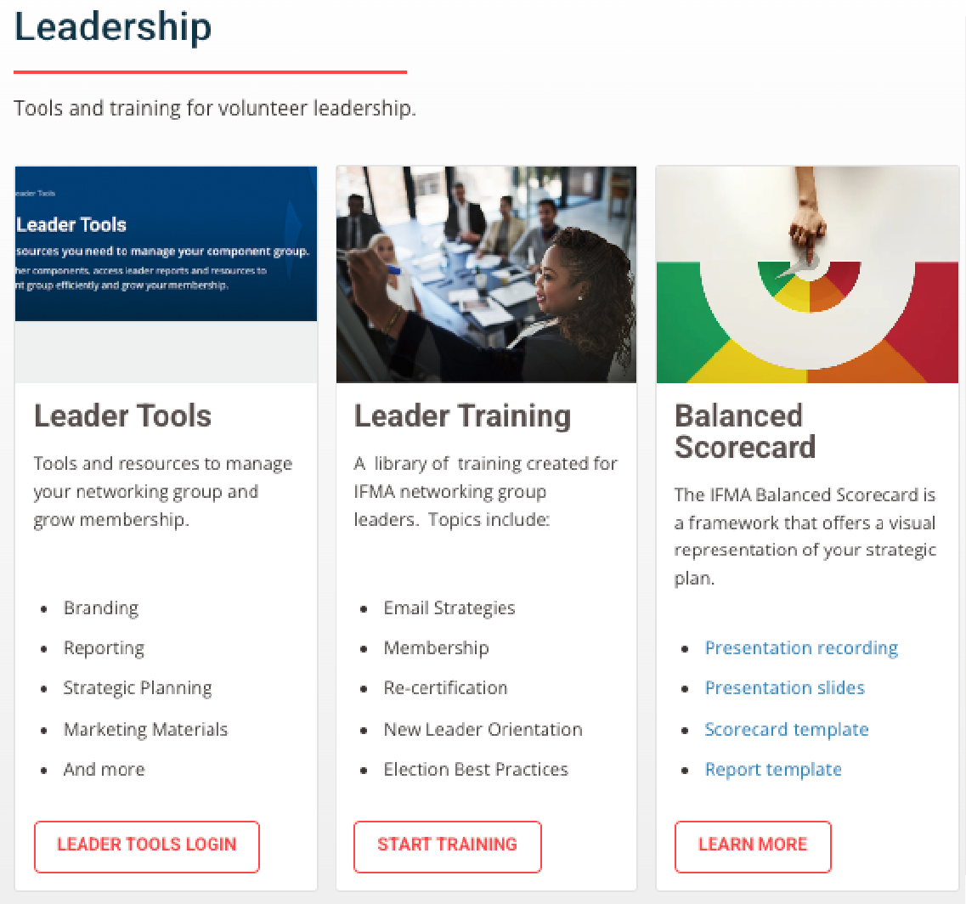



What Components Can Expect from Champions
Champions serve as resources to component leaders, providing guidance, advice and mentorship, while also sharing relevant news and updates from IFMA International.
Tools and Resources
Equip your component with tools and resources they can find through Engage, Knowledge Library and the Leader Toolkit.
Located in Champion Toolkit
IFMA News and Updates
Provide leaders with the latest IFMA news, events and opportunities like Calls for Presentations and Awards of Excellence.
Guidance and Mentorship
Support through strategic and succession planning, leveraging reporting, training and branding to guide your group to success.

Slide 9
What Champions Are Not Expected to Do
Conduct administrative tasks or duties
Provide training or presentations to the component’s general membership
Serve on the component’s board of directors or committees
Champions support and mentor the component’s leadership — they do not take on operational or leadership roles.
Engage in volunteer leadership on behalf of the component

Slide 10
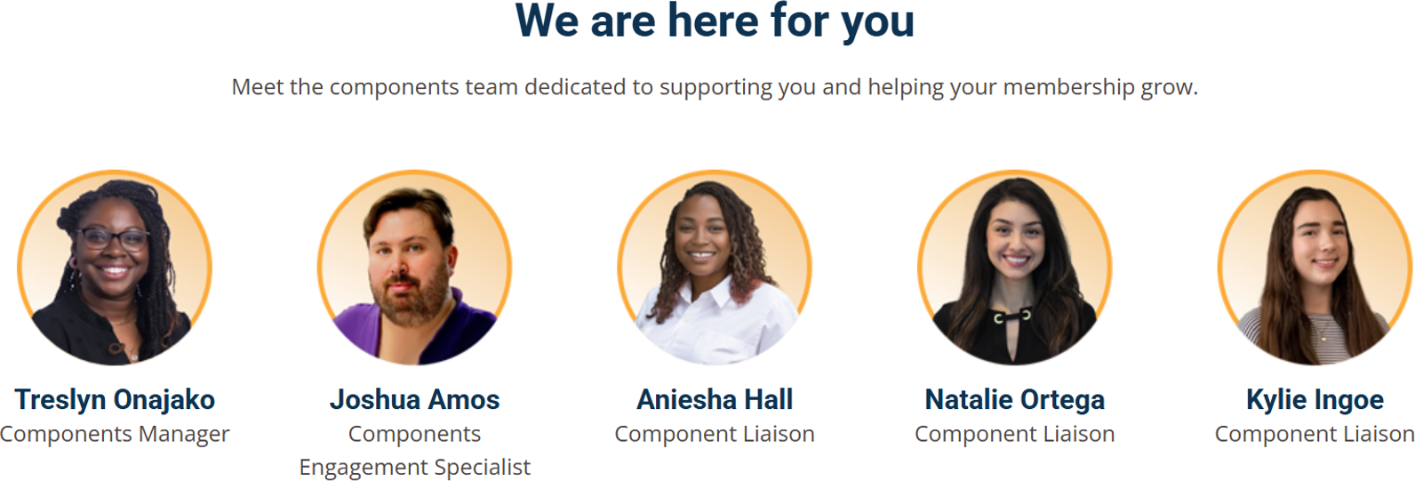
When in doubt...
...ask a Component Liaison!

Slide 11




Understanding the Component Perspective
Limited Staff
Most components have little or no paid staff — volunteers handle everything, from strategy to operations to admin tasks.
Local Focus, Global Disconnect
Chapter leaders focus on serving members locally. They may not always be aware of IFMA’s broader resources and support.
Volunteer-Driven Operations
Component boards rely heavily on volunteers and committees to get the work done.
Varied Leadership Experience
Volunteer leaders are Facility Management professionals, not association experts — leadership skills and experience vary widely.
As a Champion, you help bridge that gap — connecting components to IFMA and bringing resources, support and opportunities directly to them.

Slide 12
Engaging Through Appreciative Inquiry (AI)
What is Appreciative Inquiry?
A strengths-based, positive approach to leadership and organizational change Helps individuals, teams and organizations
build on what works to create future success
Why It’s Different
Focuses on strengths and opportunities, not just problems
Builds stronger relationships, shared vision and energized action
The Problem with Problem Solving
Identifies problem and analyzes cause Develops solutions and action plans
“Organizations are problems to be solved”
The Power of Appreciative Inquiry Focuses on strengths and opportunities Builds on what works to create the future
“Organizations are opportunities to grow”

Slide 13
Discover the Focus of Your Support
Instead of:
“What can we do to minimize membership loss?” “What does your Chapter need to do to improve?”
Change the approach:
“When were members happiest, and what worked?” “What does your Chapter do exceptionally well?”
More Examples:
What do you value most about your Component?
What does your Component look like when it’s “at it’s best”? What does your component’s ideal future look like?
What three wishes do you have now to enhance the health and vitality of your Component? What would be your best aspirations for your chapter in five years?

Slide 14


Discover Positive Core Strengths
Achievements Strategic opportunities Product strengths Technical assets Innovations
Elevated thoughts
Best business practices Positive emotions Financial assets Cooperative moments Organization wisdom Core competencies
Vital traditions and values Social capital
Embedded knowledge Business ecosystems Customer loyalty
Alliances and partnerships
Sample Questions:
Think of a time in your entire experience with your Component when you have felt the most excited, most engaged. What were the forces and factors that made it a great experience?
What was it about you, others, and your Component that made it a peak experience for you?
What is it your component is doing, here and now, that makes you really proud?
What does your component do exceptionally well?
What are the core factors that “give life” to your Component, without which your Component would cease to exist?

Slide 15
Example: ABC Chapter
Chapter Value:
Strong commitment from long-time members
When at Its Best:
High event turnout
Widespread member engagement High member satisfaction
Their Ideal Future:
Rapid growth of new members
Young Professionals active in leadership Chapter of the Year Award recipient
Strengths & Opportunities:
Excellent at welcoming new members and creating original content
Small but dedicated volunteer base and publications as “Core Factors”
Proud of an inclusive, family-like atmosphere
FOCUS: Membership Growth & Volunteer Engagement
CORE STRENGTHS: Products, Thought Leadership, Positive Emotions

Slide 16


How to Support “ABC Chapter” as a Champion
ABC Chapter’s Ideal Future: Rapid growth, YPs highly engaged in leadership, receive “Chapter of the Year” award
APPROACH:
Share: relevant IFMA resources and tools on membership and volunteer engagement
TOOLS & RESOURCES:
Membership Benefits
Advise: Best practices for growing membership, highlighting your positive cores, how to model a “Best Chapter” and applying for Awards of Excellence
Membership Pricing Guide
Awards of Excellence
Mentor: How to motivate volunteerism
Engage Forums
Connect: With other Component Leaders
Regional Advisory Boards

Slide 17









Professional Growth
Access to industry-leading certifications (FMP®, SFP®, CFM®) and training that support career advancement. Find new opportunities with IFMA’s JobNet.
Connection
Engagement through local chapters, industry councils and global communities across 140+ countries.
Tools & Resources:
IFMA Membership
Events & Experiences
Discounted access to IFMA’s conferences, regional events and member-only experiences that strengthen community and collaboration.
Resources
Unlimited access to IFMA’s Knowledge Library, FMJ magazine, with opportunities to explore benchmarking tools and research resources.
Recognition
Opportunities to present, publish, mentor or lead within the association and the wider FM community.

Slide 18
Tools & Resources: Member Pricing
Full Membership Limited Membership
FM Professional
STARTS AT*
$269/yr
For facility practitioners and educators who work in, oversee or teach in the field of FM.
Associate
Young Professional
Discovery
STARTS AT*
$239/yr
For business development, sales, marketing and FM consultant professionals.
STARTS AT*
$149/yr
For facility management professionals age 35 and under.
$49/yr
Limited membership for those interested in facility management or who work in other professions.
Intro to the FM industry Latest news and info Limited member benefits^
Great job opportunities Discount pricing Professional network growth Gain confidence as a FM
Industry-leading training Discount pricing
Career advancement Local networking
Access to decision makers Discount pricing
Grow your credibility
Connect with FMs and leaders
Available to new members only
* Full first-time members must join a chapter, council or community for their first year of membership
^ Discovery members have access to limited membership benefits.
Access the full Member Pricing Guide for details on group memberships, components and more.

Slide 19

Why should my component apply for Awards of Excellence?
Recognition
Achievements are celebrated on a global stage, highlighting the contributions of chapters, councils and communities within the profession.
The Awards of Excellence are IFMA’s highest honor, recognizing outstanding chapters, councils and communities for their leadership, innovation, member engagement and impact. These awards celebrate the volunteers and groups who go above and beyond to advance the facility management profession and strengthen the IFMA community.
Visibility
Increased exposure within IFMA and the broader facility management industry raises awareness of programs, events and leadership.
Credibility
A strong reputation as a thought leader within the IFMA community helps attract members, partners and new opportunities.

Slide 20
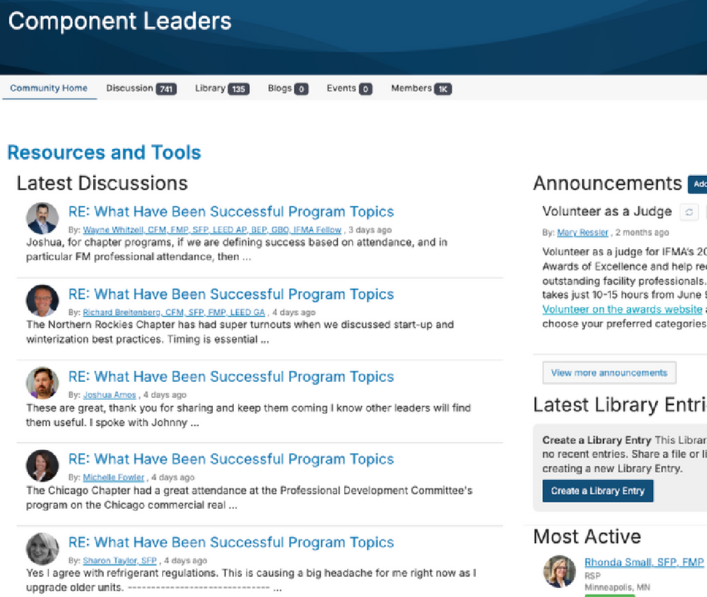
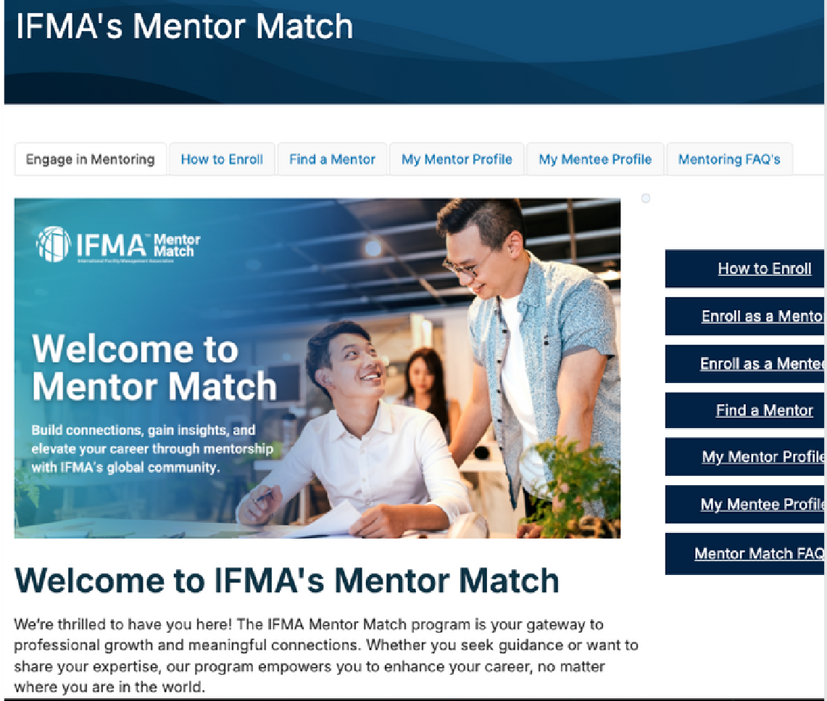
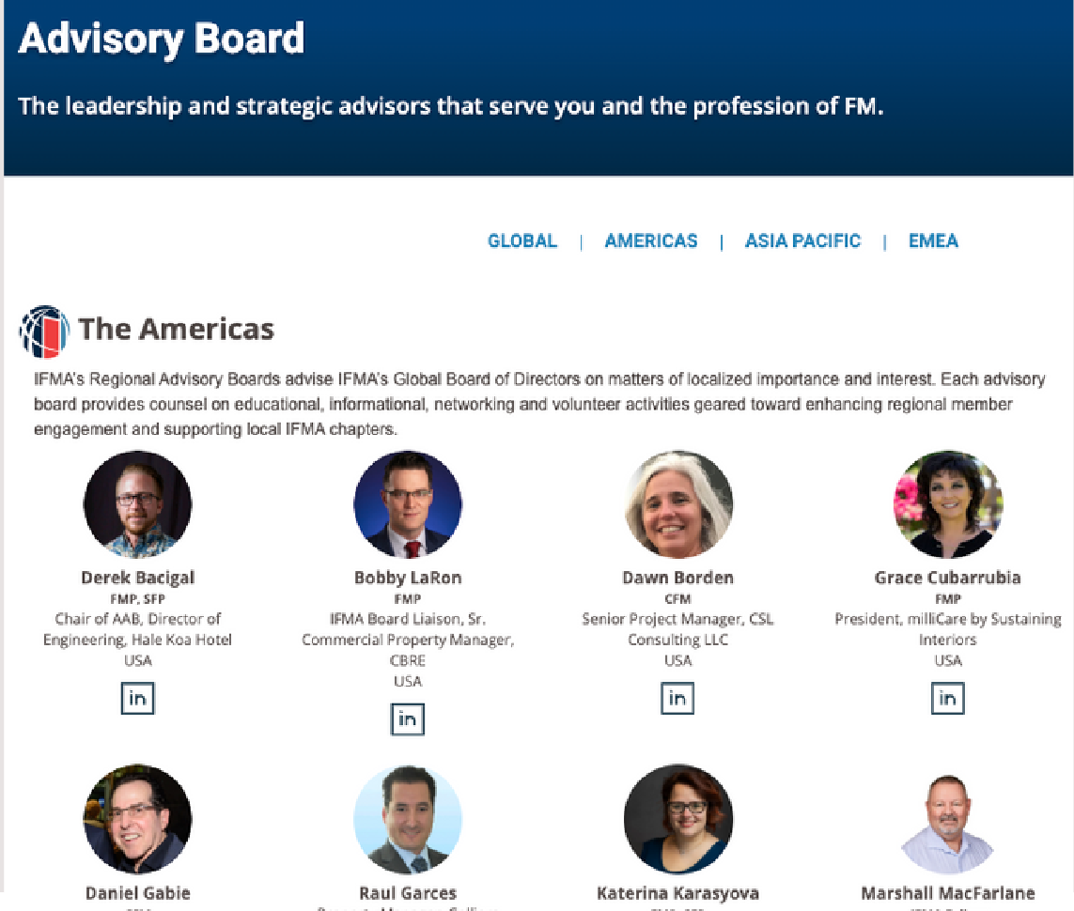

Tools & Resources: Leader Connection
Provide these resources to connect leaders globally, support mentorship and motivate volunteerism.
Component Leader Forum
Encourage leaders to join this online space to ask questions, share challenges and connect with peers.
Mentor Match
Show leaders how to find or become a mentor
— a great way to support professional growth and build connections.
Regional Advisory Boards
Introduce leaders to their Regional Advisory Board — a direct link to IFMA leadership and a way to elevate their voice.

Slide 21
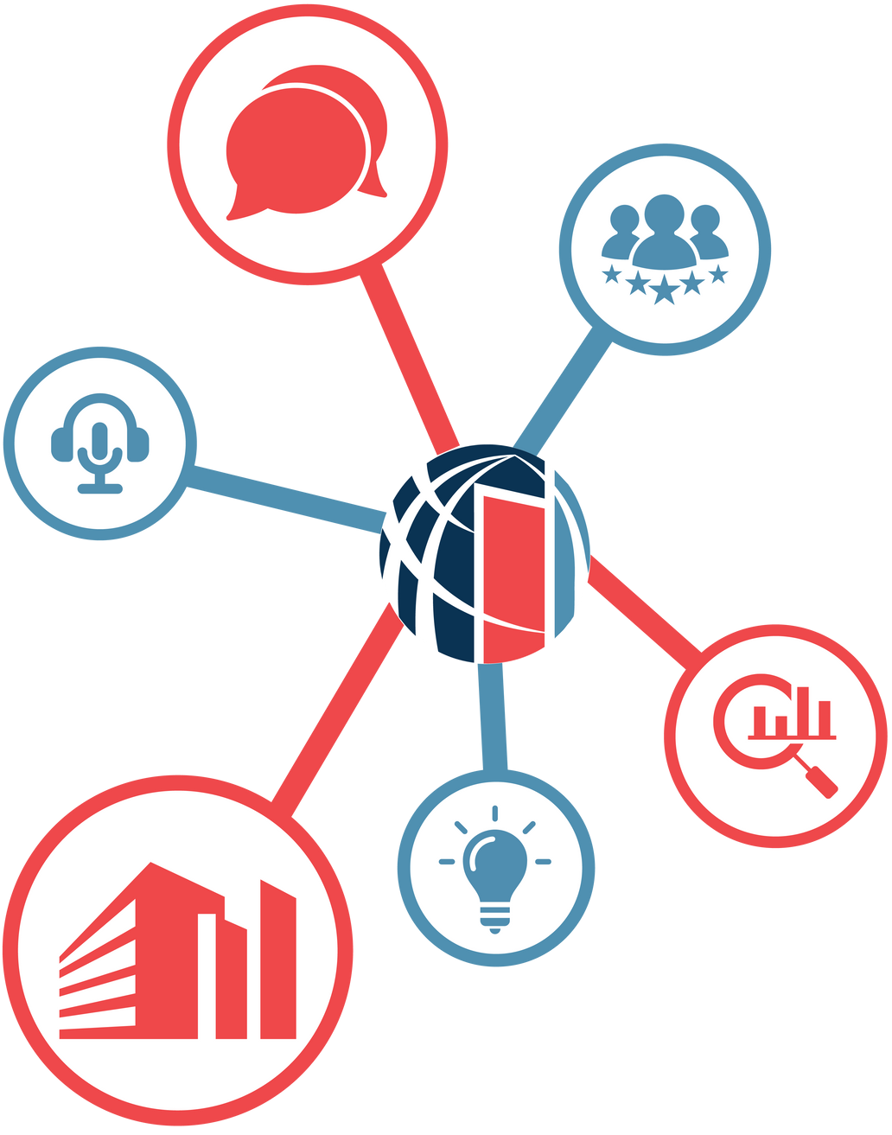

Additional Resources for Success
Connected FM Blog
The Connected FM Blog delivers expert insights, trends and strategies shaping the future of facility management.
Connected FM Podcast
IFMA’s Connected FM Podcast channel features conversations with professionals on trends, challenges and innovations in facility management.
The Wire & Insider Newsletters
Weekly members-only newsletters and FM industry news—featuring global headlines, regional insights and association opportunities.
Research and Benchmarking
Our Research and Benchmarking department conducts in-depth data analysis, bench-marking and forecasting of key FM trends.
Guides, White Papers and Practical Tools
Our digital Knowledge Library houses a variety of FM content reviewed by experts, from presentations and blog posts to white papers and practical how-to guides.
IFMA’s flagship digital magazine highlights thought leaders, best practices and emerging trends—delivering practical takeaways and scalable strategies from workplace professionals.

Slide 22










Common Topics of Interest for Components
Membership
Marketing & Communications Templates
Strategic Planning Relationship Building Awards of Excellence Succession Planning
IFMA Events IFMA Foundation
Workforce Development Scholarships
IFMA Fellows Professional Development IFMA Credentials

Slide 23

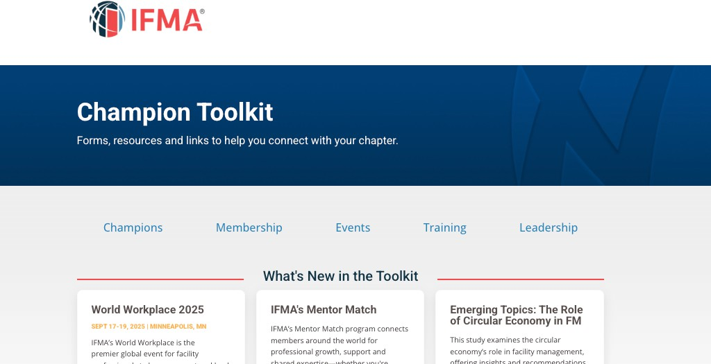
The Champion Toolkit
Your one-stop shop for IFMA resources to support your component.
Only for Champions — not available on IFMA’s public site.
Access now

Slide 24
Q_{&A}
Additional questions? Email components@ ifma.org

