Slide 1


Accessing the Value of IFMA
Empowering Facility Professionals Worldwide
Copyright © 2023 ‹#›

Slide 2
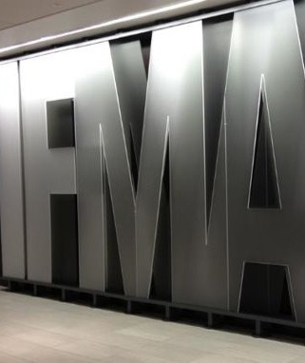


Who is IFMA?
Founded in 1980, the International Facility Management Association (IFMA) is the world's largest and most widely recognized association for facility management professionals, supporting over 25,000 members in more than 140 countries.
Copyright © 2023

Slide 3




Our Purpose and Values that Drive Us
Our Vision
Lead the future of the built environment to
make the world a better place.
Global diversity, inclusion and social equality
Sustainability, resilience and responsible stewardship
Open, honest, transparent and interactive communications
Growth through innovation, leadership and sharing of knowledge
Our Mission
We advance our collective knowledge, value and growth for Facility Management professionals to perform at the highest level.

Slide 4


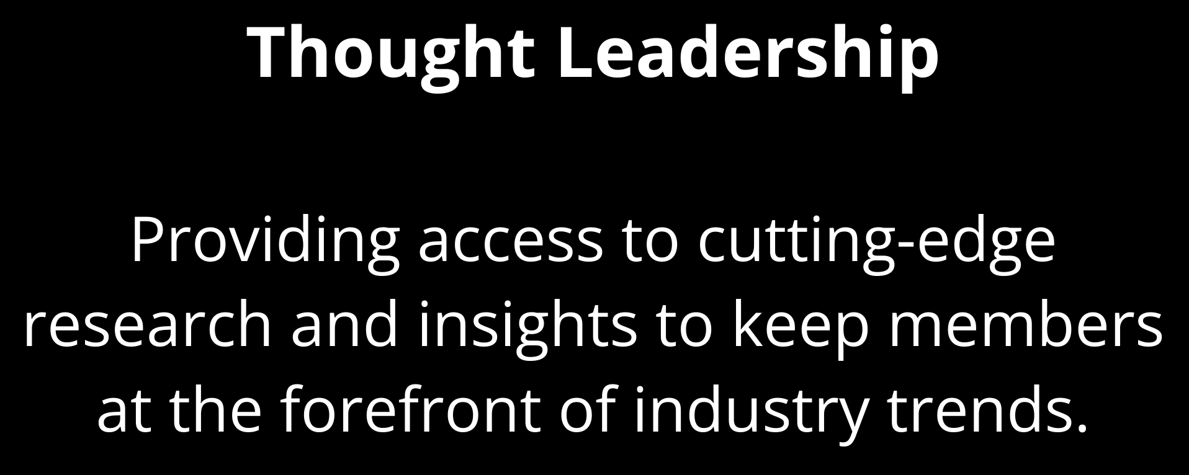
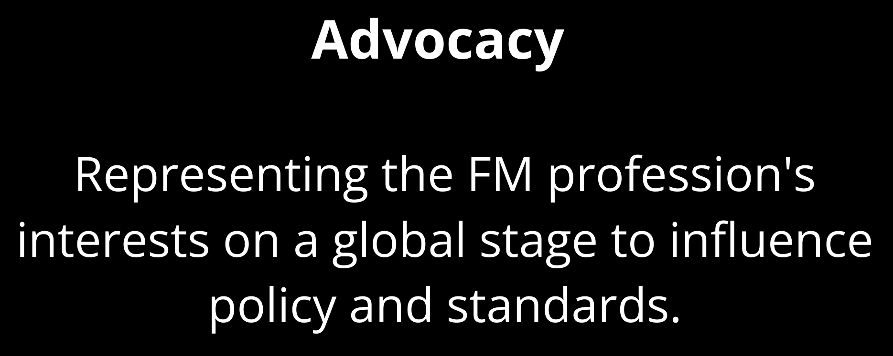
Empowering FM Professionals Worldwide
IFMA is committed to empowering facility management professionals through:

Slide 5









Professional Growth
Access to industry-leading certifications (FMP®, SFP®, CFM®) and training that support career advancement.
Connection
Engagement through local chapters, industry councils and global communities across 140+ countries.
Membership that strengthens the profession
Built to advance knowledge, expand networks and elevate careers in facility management.
Experiences
Discounted access to IFMA’s conferences, regional events and member-only experiences that strengthen community and collaboration.
Resources
Unlimited access to IFMA’s Knowledge Library, FMJ magazine, with opportunities to explore benchmarking tools and research resources.
Recognition
Opportunities to present, publish, mentor or lead within the association and the wider FM community.

Slide 6
Globally Recognized + ANSI-Accredited Credentials
Unbiased review of IFMA’s credentials Protects integrity, value, and reputation ANSI is North American arm of ISO

Slide 7






¹tiiI�FM/.r fm.training
Login
Featured Learning
Show All >
Search Catalog
Featured News
Latest
FMP®BUNDLE

Slide 8


Group Training
Performance with IFMA credential increases an average of 40%
On average, IFMA credentials lead to a $6,000 salary increase within the first year

Slide 9
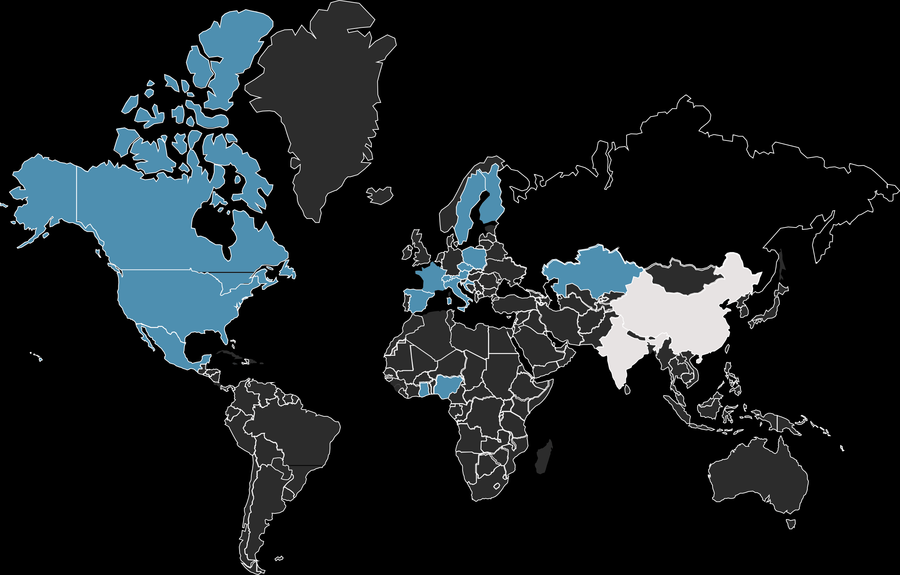

Local Networking with Chapters

Slide 10


Industry Networking with Councils
Academic Facilities Airport Facilities
Banking Institutions & Credit Unions City & Country Clubs
Corporate Facilities FM Consultants Health Care Hospitality
Legal Industry Manufacturing Museum/Cultural Institutions Nonprofit Facilities
Public Sector
Research & Development Retail Facilities
Utilities

Slide 11







Topical Networking with Communities

Slide 12

Engage in our Online Community
Ask real-time questions and crowdsource solutions from fellow FM professionals
Share insights, tools and best practices across industries and regions
Stay up to date with announcements, discussions and shared resources
Join focused groups tied to professional interests
Expand connections beyond geographic boundaries

Slide 13







Events that Inspire and Connect
From local meetups to global summits, IFMA events bring the facility management community together to share knowledge, solve challenges and lead the profession forward.
Global Events
2026 dates to be announced soon!
IFMA’s premier global conference, combining education, innovation and networking in one powerful event.
A regional experience focused on leadership development and tactical strategies for today’s FM challenges.
Webinars & Virtual Trainings
Live and on-demand education led by FM experts—offered throughout the year.
Local Chapter & Council Events
Community-driven programs tailored to local markets and industry sectors.

Slide 14


Resources for Success
Connected FM Blog
The Connected FM Blog delivers expert insights, trends and strategies shaping the future of facility management.
Connected FM Podcast
IFMA’s Connected FM Podcast channel features conversations with professionals on trends, challenges and innovations in facility management.
The Wire & Insider Newsletters
Weekly members-only newsletters and FM industry news—featuring global headlines, regional insights and association opportunities.
Research and Benchmarking
Our Research and Benchmarking department conducts in-depth data analysis, bench-marking and forecasting of key FM trends.
Guides, White Papers and Practical Tools
Our digital Knowledge Library houses a variety of FM content reviewed by experts, from presentations and blog posts to white papers and practical how-to guides.
IFMA’s flagship digital magazine highlights thought leaders, best practices and emerging trends—delivering practical takeaways and scalable strategies from workplace professionals.

Slide 15

Recognition that Builds Credibility
Present at World Workplace, Facility Fusion or webinars to share expertise and build professional visibility
Publish articles, tools or insights in FMJ or the Knowledge Library to contribute to the profession
Mentor rising professionals through IFMA’s Mentor Match
program and support career development
Take on leadership roles within chapters, councils or global committees to shape programs and initiatives
Receive recognition through IFMA’s Awards of Excellence for outstanding industry contributions

Slide 16
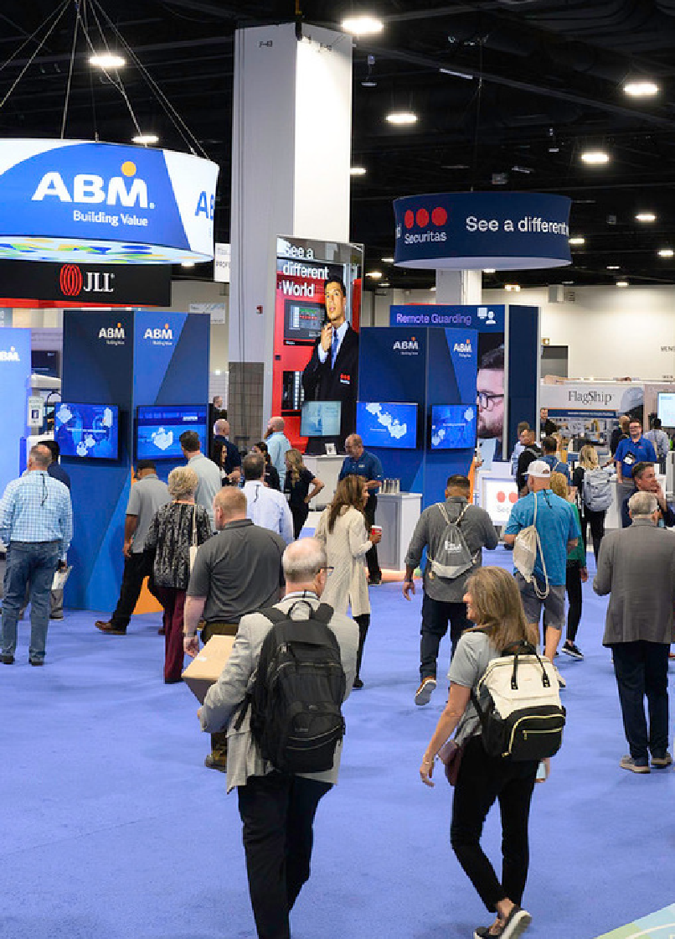




Strategic Exposure for Solution Providers
Connect with facility management professionals through strategic exhibits, partnerships and advertising opportunities.
Exhibit
Showcase products and services at World Workplace, Facility Fusion and other IFMA events.
Advertise
Reach FM professionals through FMJ magazine, IFMA.org and digital newsletters.
Sponsorship
Enhance brand visibility through custom sponsorships of IFMA programs and events.
Corporate Partnership
Become a Corporate Sustaining Parnter (CSP) through thought leadership and expertise

Slide 17
Find Your IFMA Membership
Full Membership
Limited Membership
FM Professional
STARTS AT*
$269/yr
For facility practitioners and educators who work in, oversee or teach in the field of FM.
Associate
Young Professional
Discovery
STARTS AT*
$239/yr
For business development, sales, marketing and FM consultant professionals.
STARTS AT*
$149/yr
For facility management professionals age 35 and under.
$49/yr
Limited membership for those interested in facility management or who work in other professions.
Intro to the FM industry Latest news and info Limited member benefits^
Great job opportunities Discount pricing Professional network growth Gain confidence as a FM
Industry-leading training Discount pricing
Career advancement Local networking
Access to decision makers Discount pricing
Grow your credibility
Connect with FMs and leaders
Available to new members only
* Full first-time members must join a chapter, council or community for their first year of membership
^ Discovery members have access to limited membership benefits.

Slide 18



Questions?
+1-713-623-4362
ifma.org
ifma@ifma.org

